Slide 1

Formal Validation of Neural Networks as Timed Automata

Slide 2
Introduction
We encode LIF networks into timed automata.
We analyse some intrinsic properties of the proposed model.
We encode in temporal logics all the behaviours.
We prove limits of LIF model to hold for our model.

Slide 3
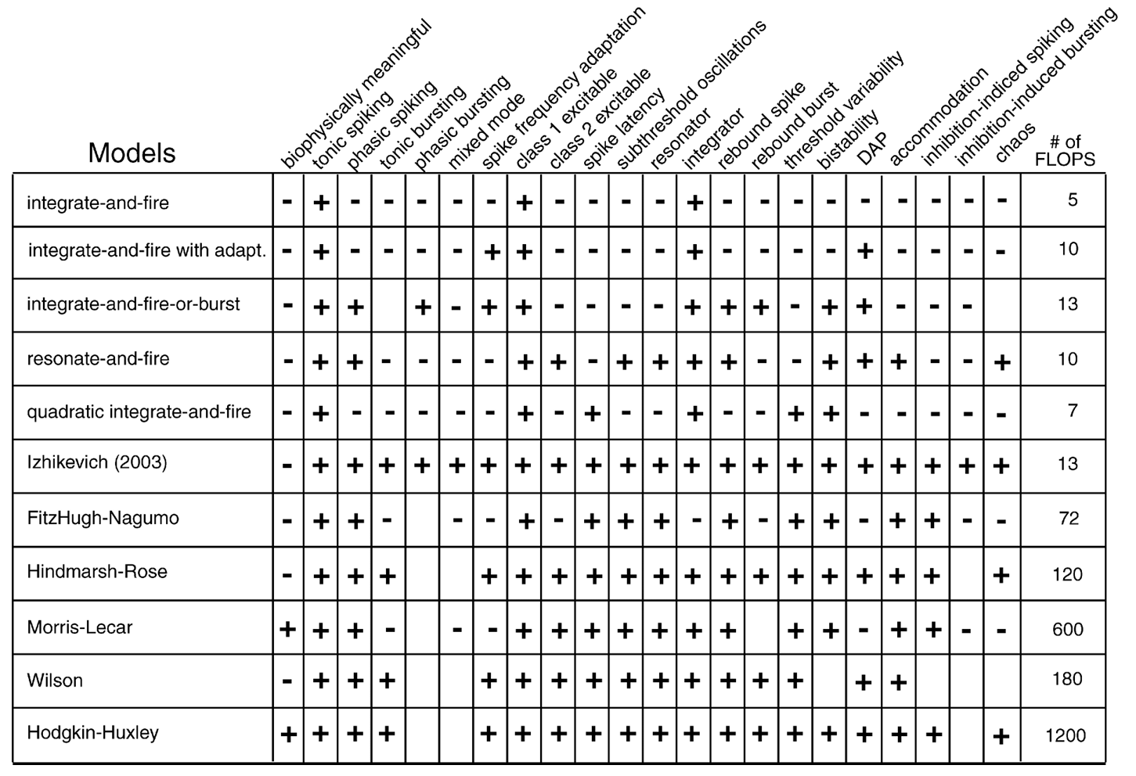
Introduction

Slide 4
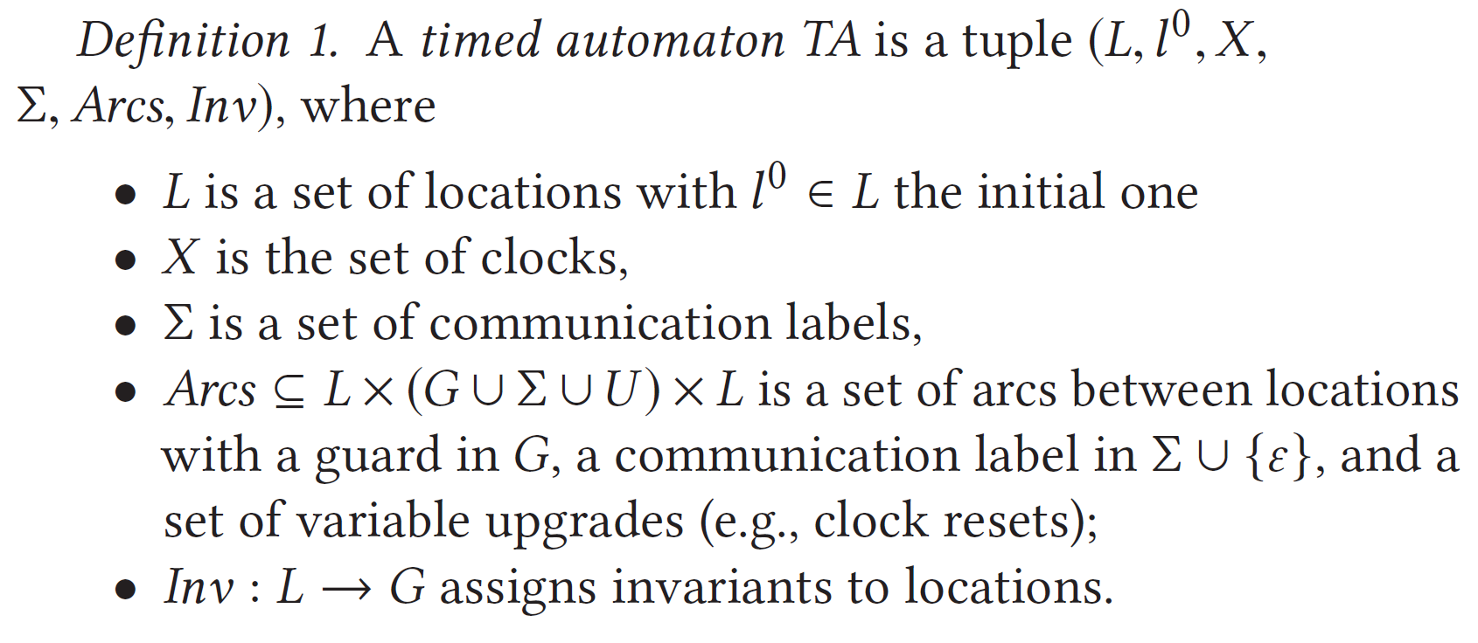
Preliminaries

Slide 5
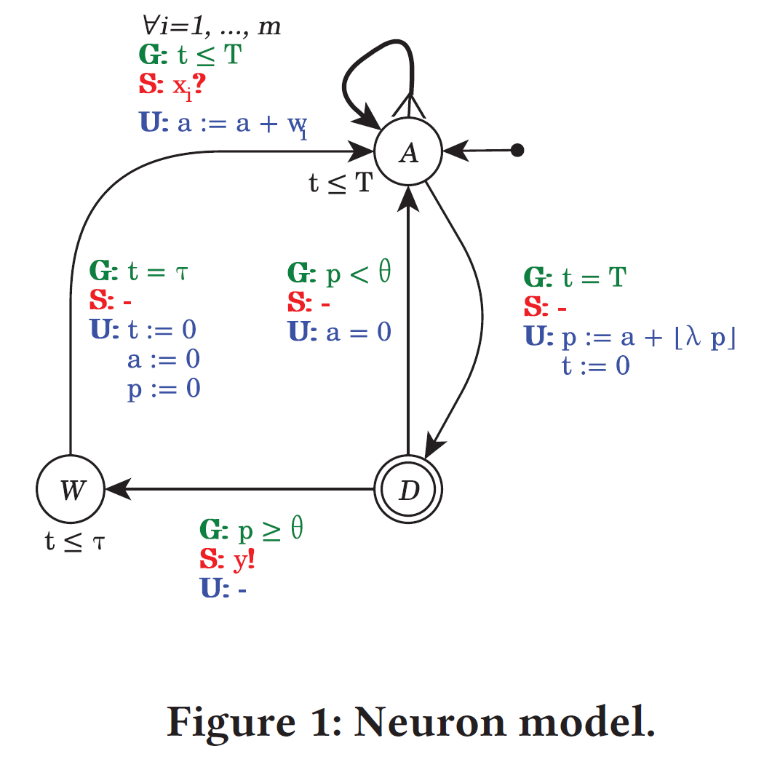
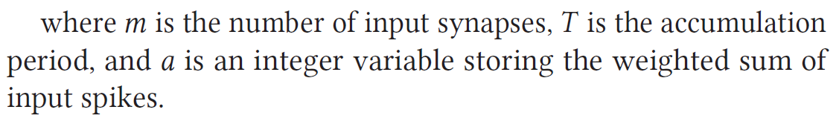
LIF Neuron

Slide 6
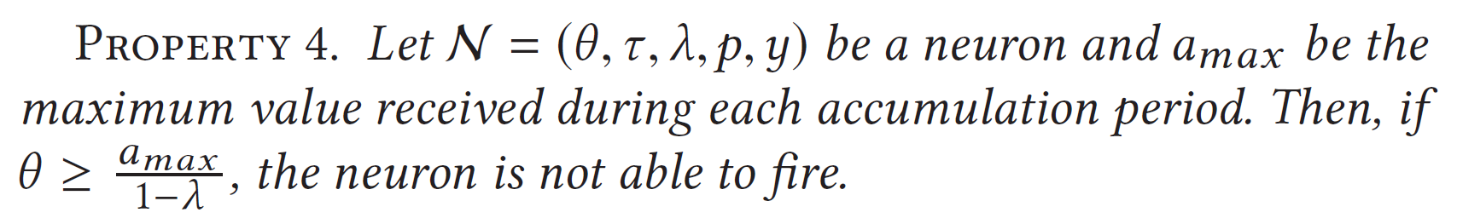

Properties

Slide 7
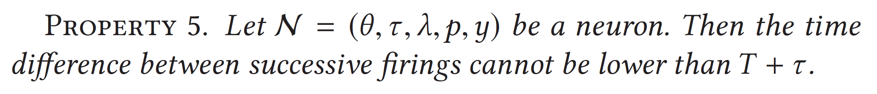

Properties

Slide 8
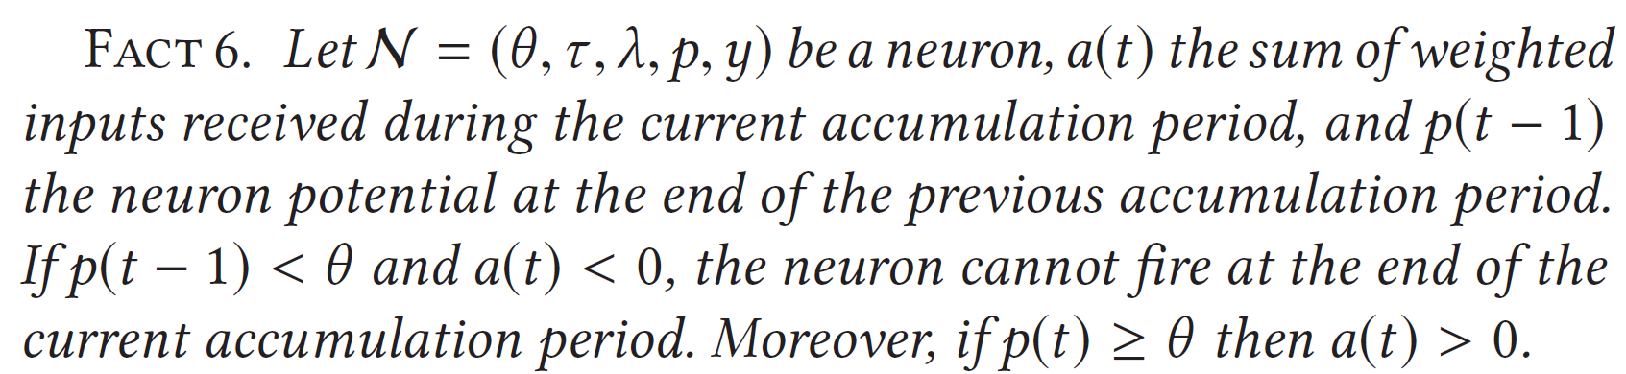
Properties

Slide 9
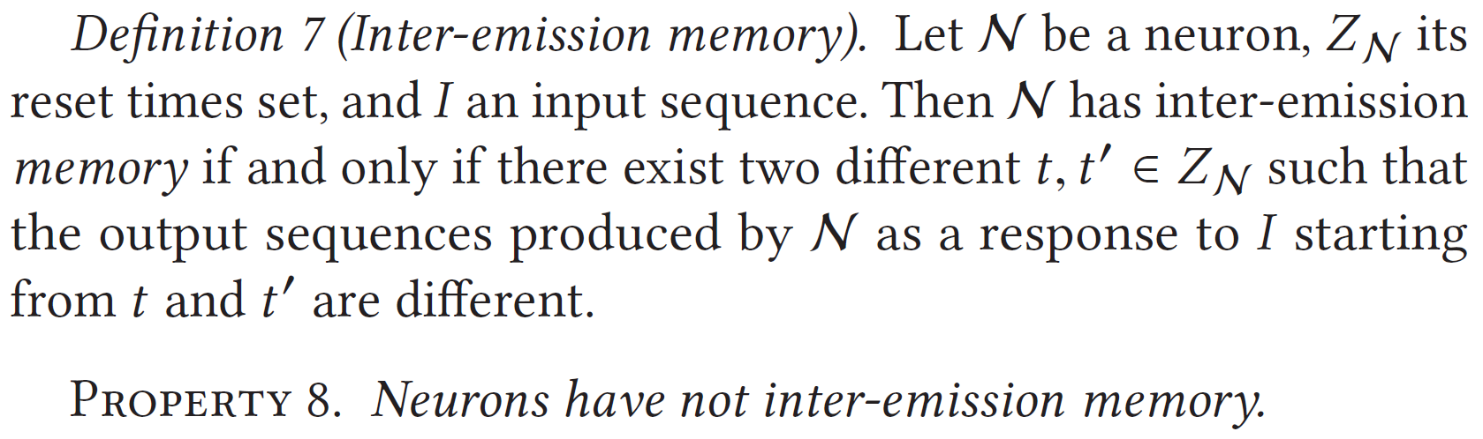
Properties

Slide 10
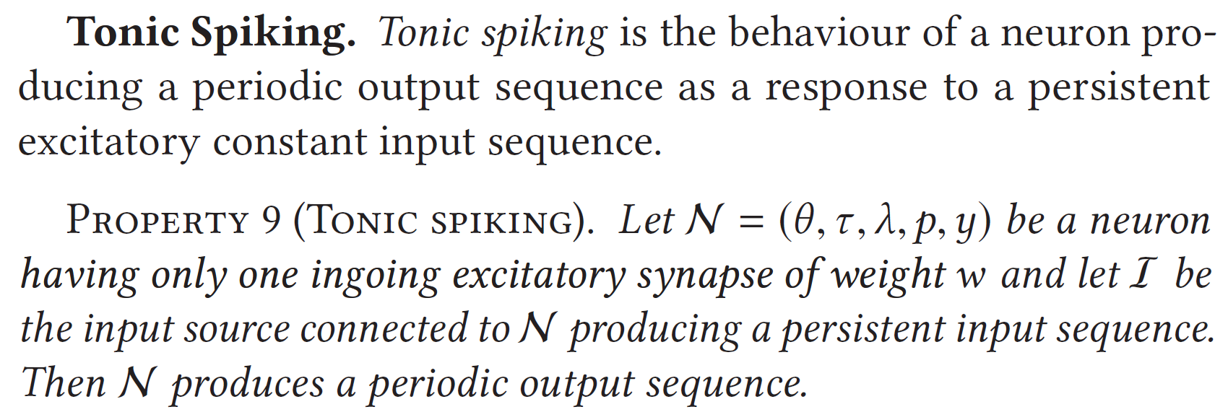

VALIDATION OF THE MODEL

Slide 11
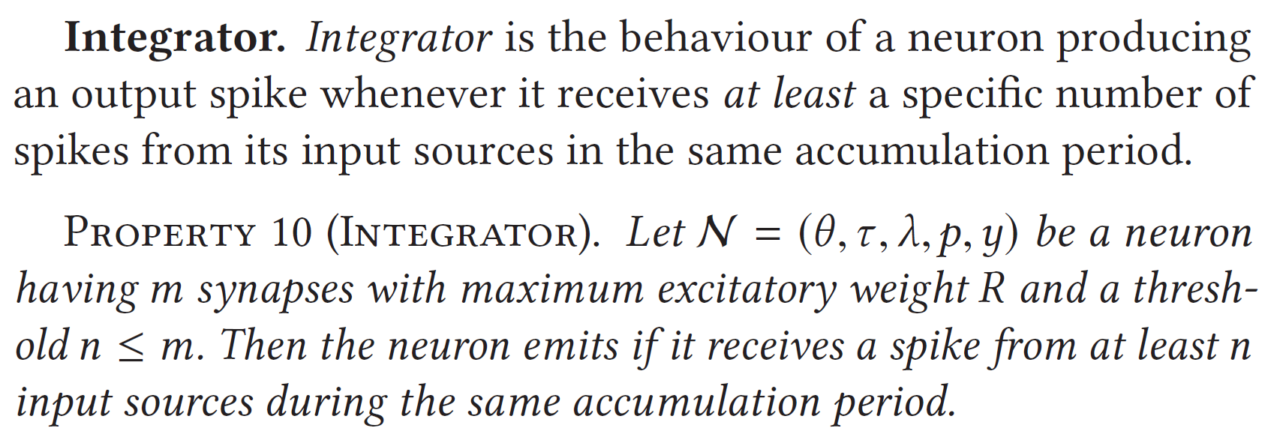
VALIDATION OF THE MODEL

Slide 12
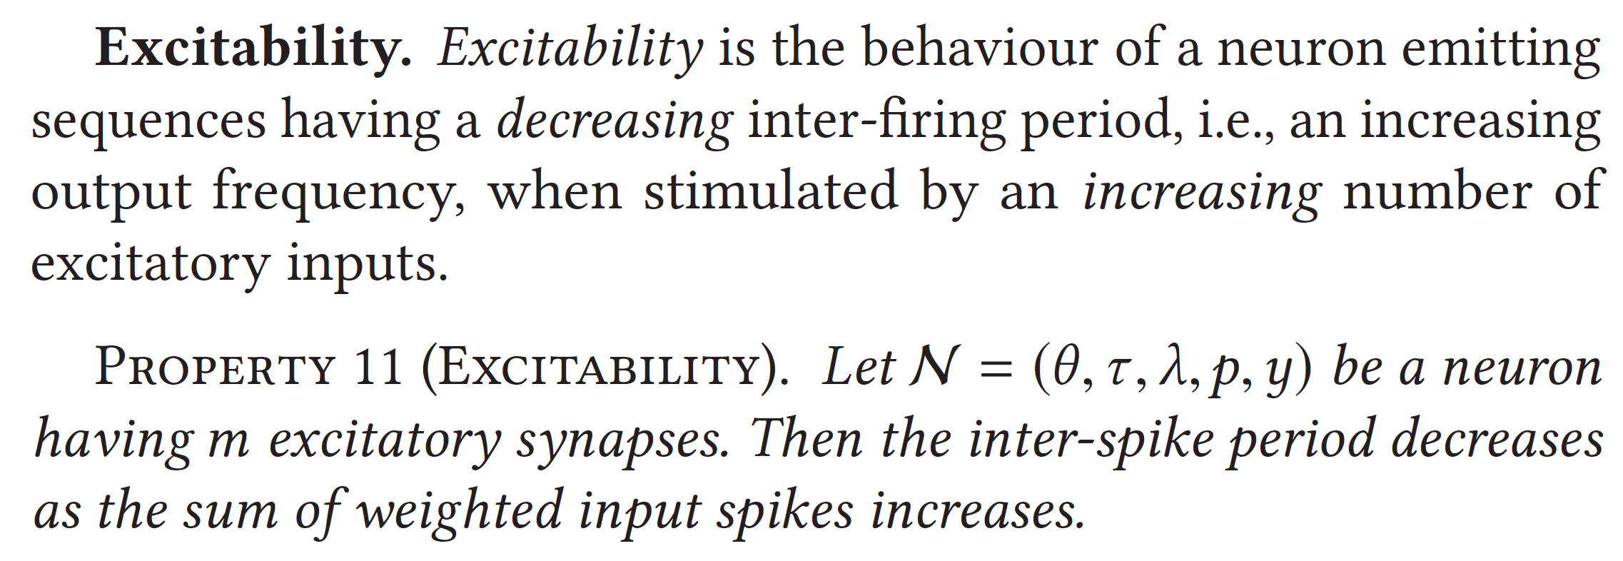
VALIDATION OF THE MODEL

Slide 13
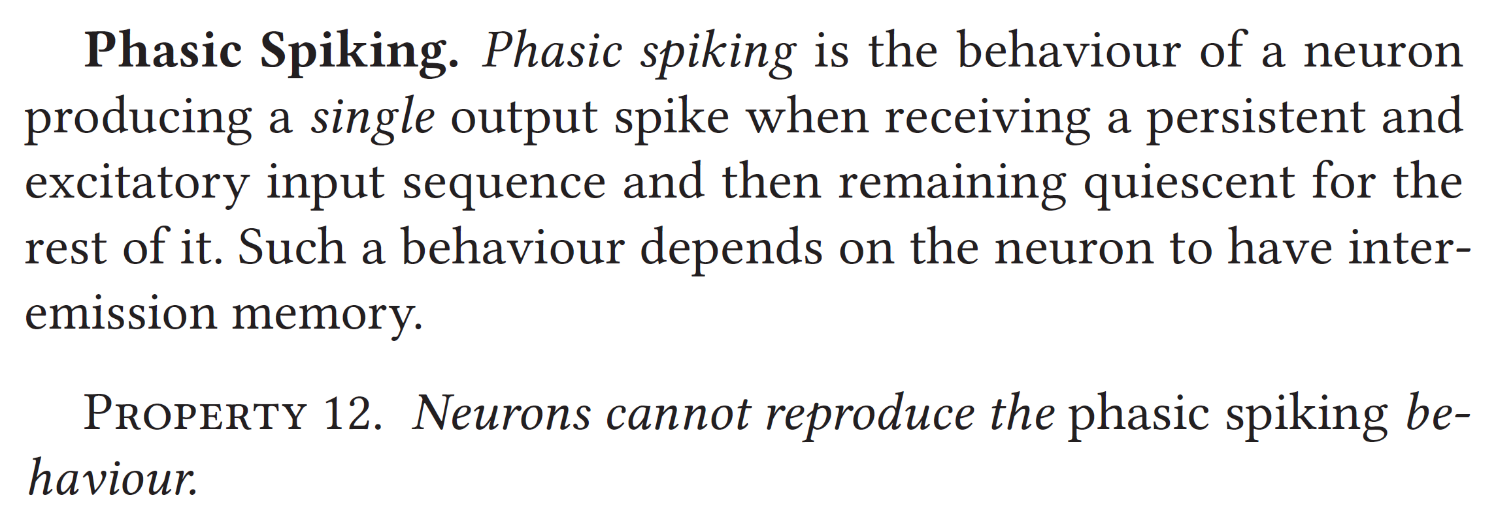

VALIDATION OF THE MODEL

Slide 14
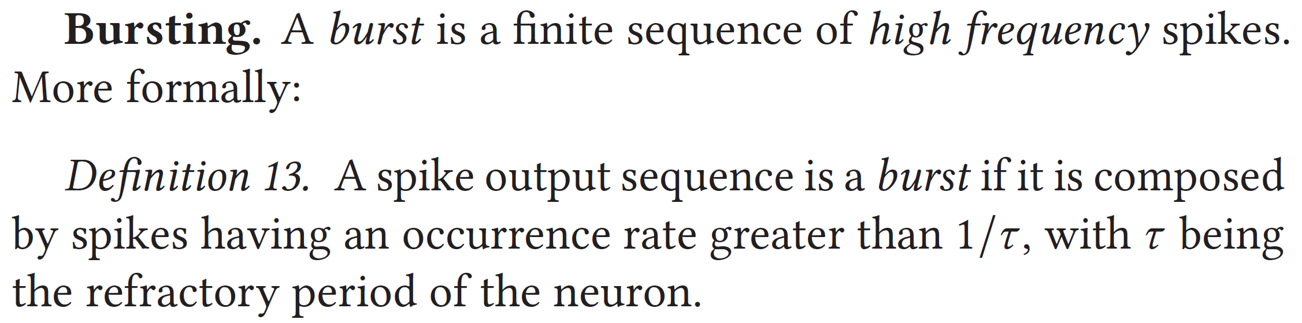
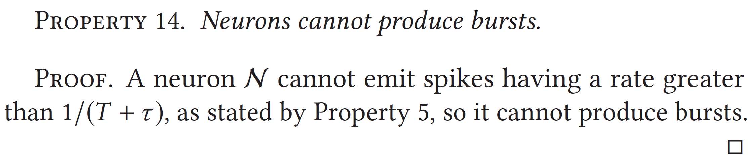
VALIDATION OF THE MODEL

Slide 15
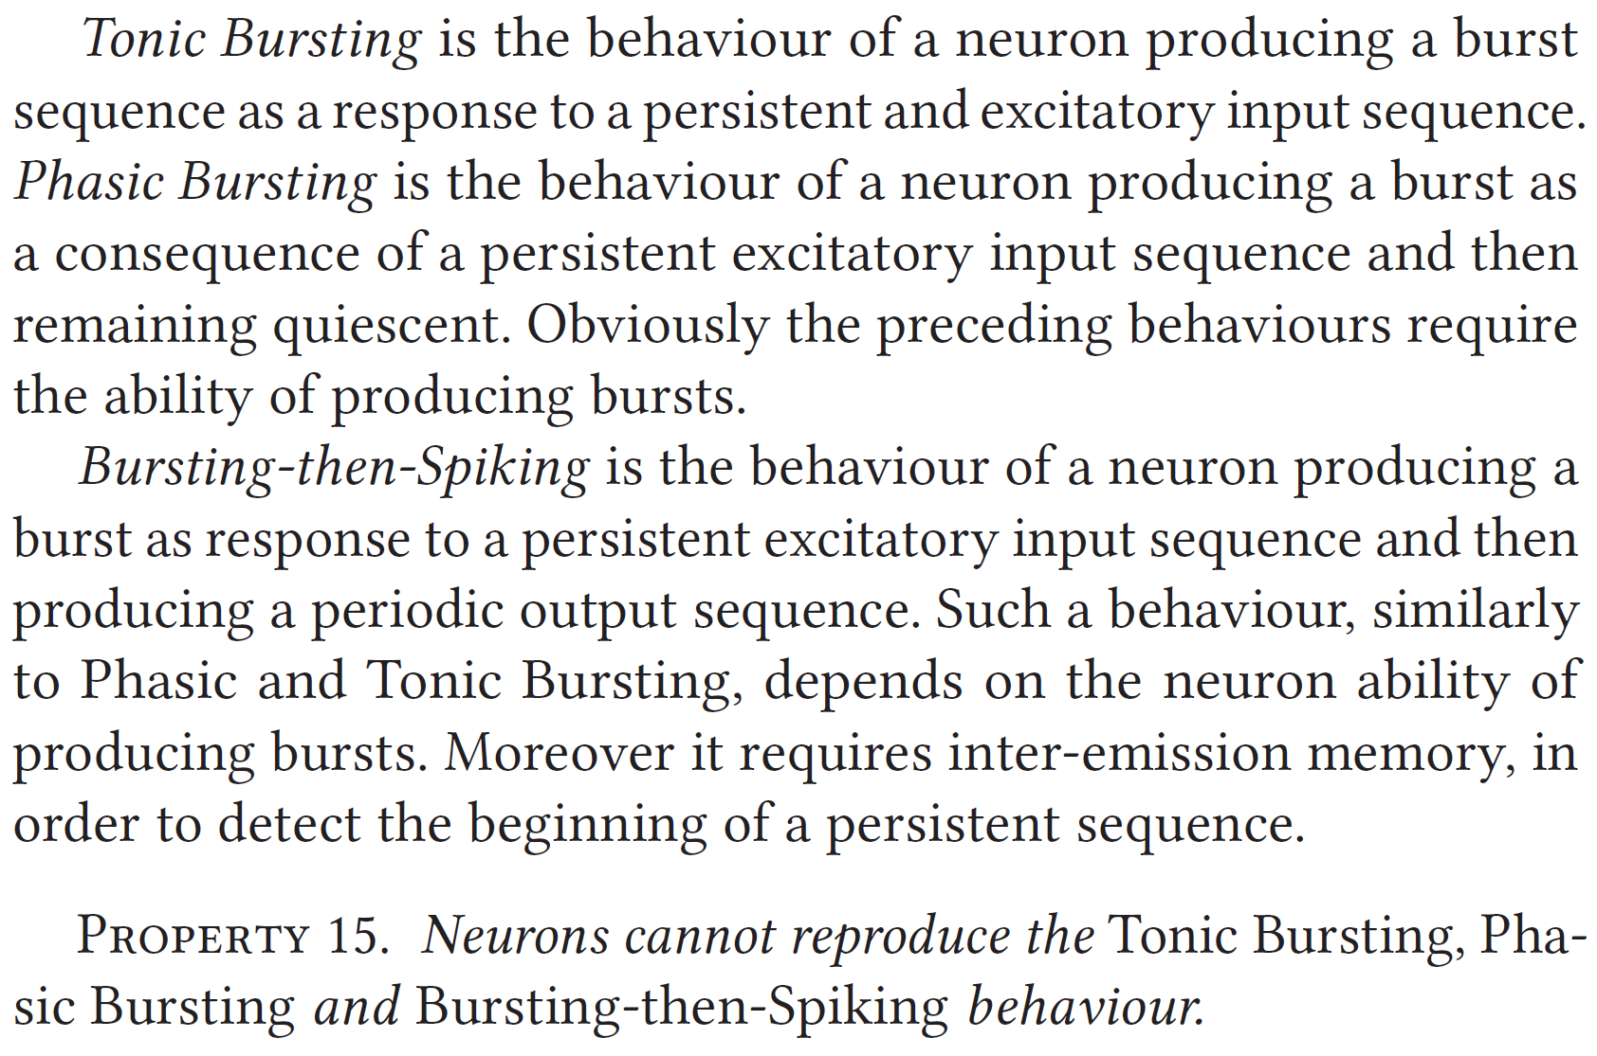





VALIDATION OF THE MODEL

Slide 16
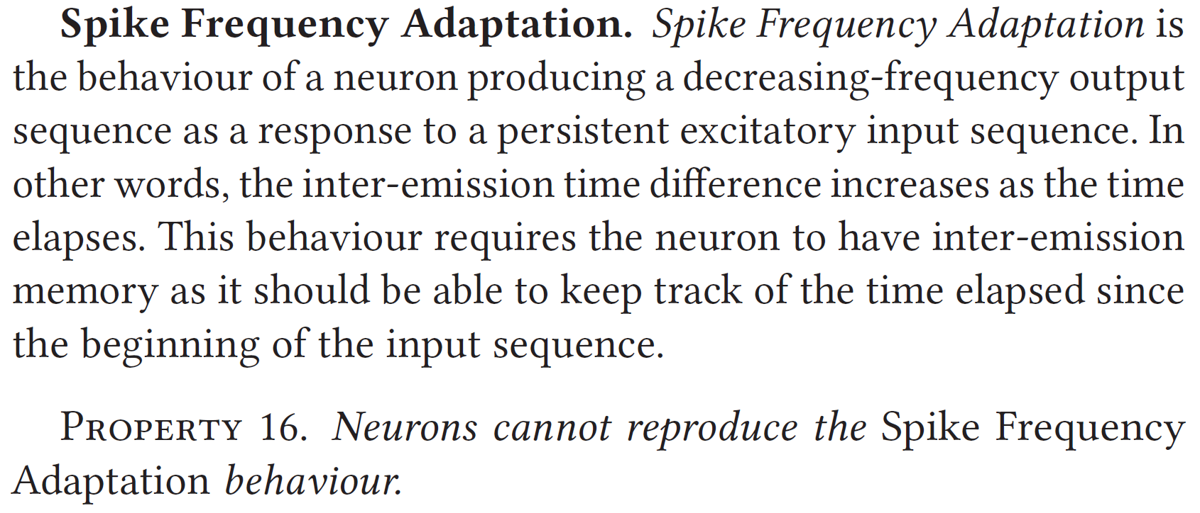

VALIDATION OF THE MODEL

Slide 17
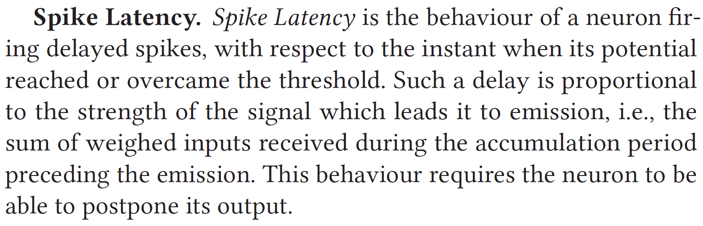


VALIDATION OF THE MODEL

Slide 18
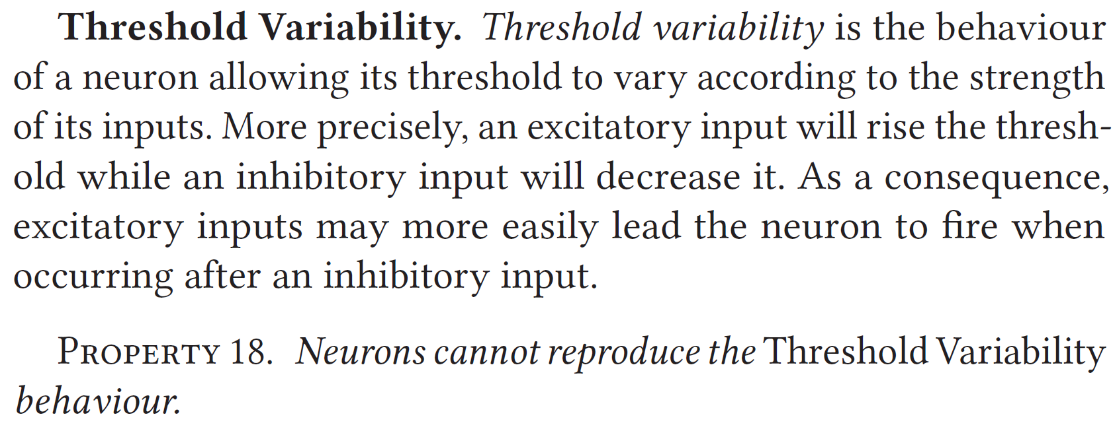

VALIDATION OF THE MODEL

Slide 19
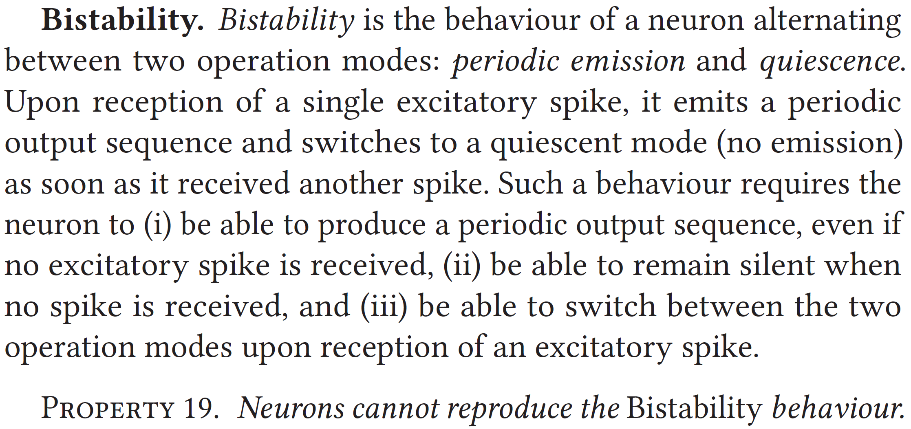

VALIDATION OF THE MODEL

Slide 20
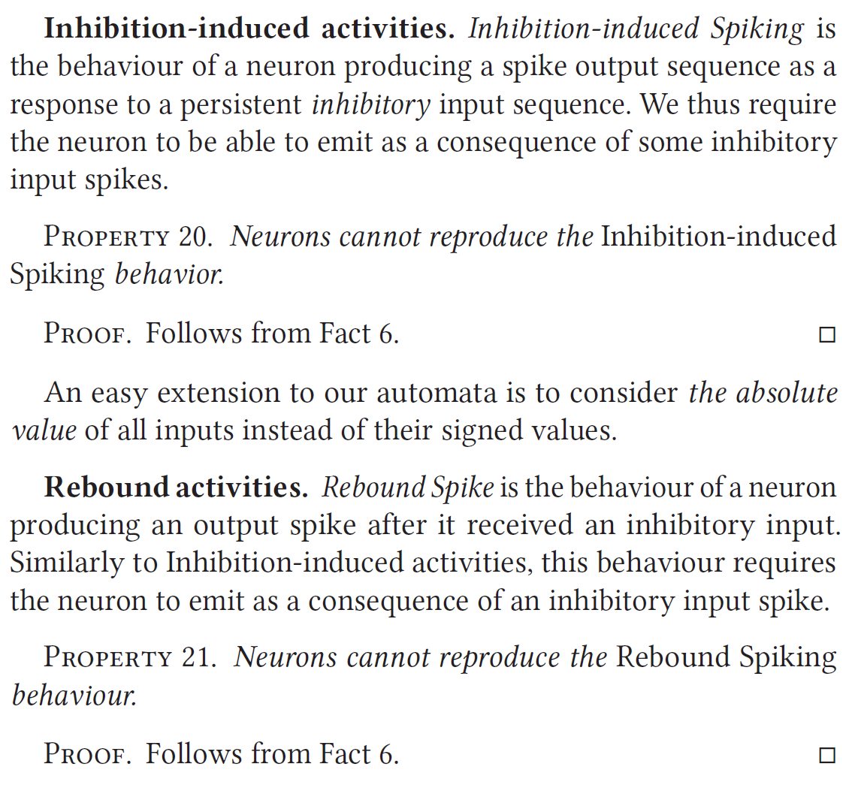

VALIDATION OF THE MODEL

Slide 21
Conclusion
Our work is the first Timed Automata analysis of spiking neural network.

